Slide 1
Accessing the Curriculum for Diverse Learners
Prompting

Slide 2
Natural Cues
A signal to say or do something
Sounds, smells, objects, visuals or tactile representations that are consistently or predictably in the environment
Bell to signify the end of recess
Teacher directions or pause to gain attention
Important to draw student’s attention to the natural cues as they give directions (assistance) to the student
A prompt is usually not present in the environment, but must be provided by another person. EAs are an accommodation / personnel that have been inserted into the classroom environment – so they are not a natural cue, not what they do or say is viewed as “natural” when it comes to providing support.

Slide 3
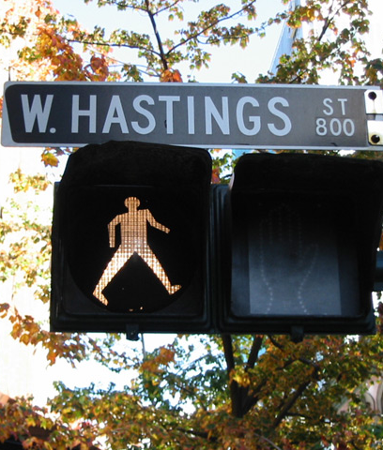
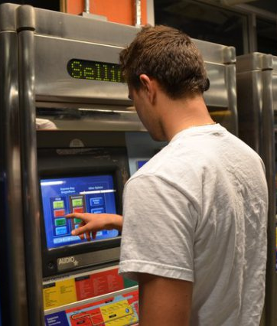
Natural Cues

Slide 4

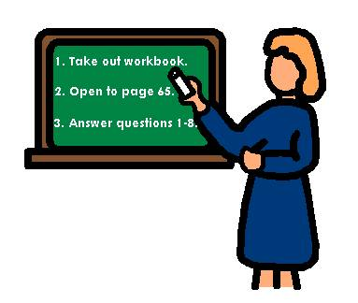
Natural Cues

Slide 5
What are prompts?
A prompt is used to increase the likelihood that an individual will engage in the correct behaviour at the correct time and place
A prompt induces a person to perform a behaviour / response that would otherwise not occur
Given before or during a behaviour
Increases learning
Reduces frustration
Provides opportunities to reinforce appropriate behaviour

Slide 6
Types of Prompts
Gestural Prompts
Visual Prompts
Verbal Prompts: direct and indirect
Modeling
Physical: partial and full

Slide 7

Prompting in a typical classroom activity

Slide 8
When do you prompt?
Instruction
Response
Reinforcement
Correction
Prompt

Slide 9
Gestural Prompts
A point or other gesture to prompt the expected response

Slide 10
Visual Prompts
The object or images acts as the stimulus for the response

Slide 11
Verbal Prompts – 2 types
Verbal instructions to perform the required actions – direct
Indirect
“What’s Next?”

Slide 12
Modeling
Demonstrate yourself or with props
Demonstration of the behaviour to be performed

Slide 13
Physical Prompts
Partial Physical – touching / guiding hands, arms or shoulder to start or move through the response
Full Physical – assisting a person through the whole response

Slide 14
Prompt scenario – do not do this in a classroom!
Bell rings.
Bulbir does not line-up for lunch.
Bulbir is told to “go line up”.
Bulbir never lines up without the verbal prompt.
Verbal prompts are easy to use and often effective, so they can become routine – MISTAKE!
Bulbir does not gain independence.

Slide 15

Keys to Success
Use the least amount of prompting as necessary
Fade the prompts as soon as possible
Remember verbal prompts are the most difficult to fade – minimize the use and amount of talk

Slide 16

The Downside of Prompts!!
Prompt Dependency
Learned Helplessness

Slide 17
What is prompt dependency?
Over-reliance or dependence on adult support as a result of how students are taught
Often a result of significant amounts of 1-1 instruction
Students become ‘used to’ being prompted and don’t try to respond on their own
Students learn they ‘might as well wait’

Slide 18
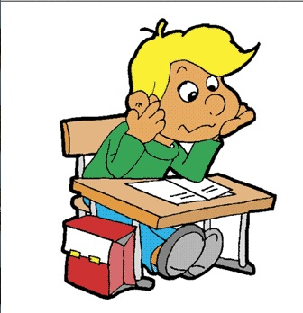
The student is thinking:
Why bother? You’re going to help me do it anyway.

Slide 19

Prompt dependency examples
The student looks at you before saying or writing an answer in academic tasks
You tell the student how to unpack his bag and hang up his coat every morning

Slide 20

Prompt dependency examples
The student needs to be told to take a bite of her favourite food
You follow the student into the bathroom and narrate his actions

Slide 21
Top 10 tips for avoiding prompt-dependency
Say what you mean, mean what you say
Use brief, clear instructions
Follow through immediately, without repeating instructions
Use the most effective, least intrusive least noticeable prompt
Fade prompts as quickly as possible

Slide 22
Only prompt when …
A student is asked a questions and s/he doesn’t answer or answers incorrectly
A student is asked to do something and s/he doesn’t do it or does it incorrectly
There is something a student should be doing (based on some environmental or natural cue) and s/he is not doing it

Slide 23

And finally, don’t forget to …
Reinforce (even approximations)
Teach all skills with a self-management component, such as activity schedules, lists, self-reinforcement. That means you need to teach the student how to be in charge.

Slide 24
Prompt scenario – do this instead …
Bell rings.
Bulbir does not line-up for lunch.
Bulbir never lines up without the direct verbal prompt: “go line up”.
What are ways to prompt her without the direct verbal prompt?
Bulbir gains independence.

Slide 25
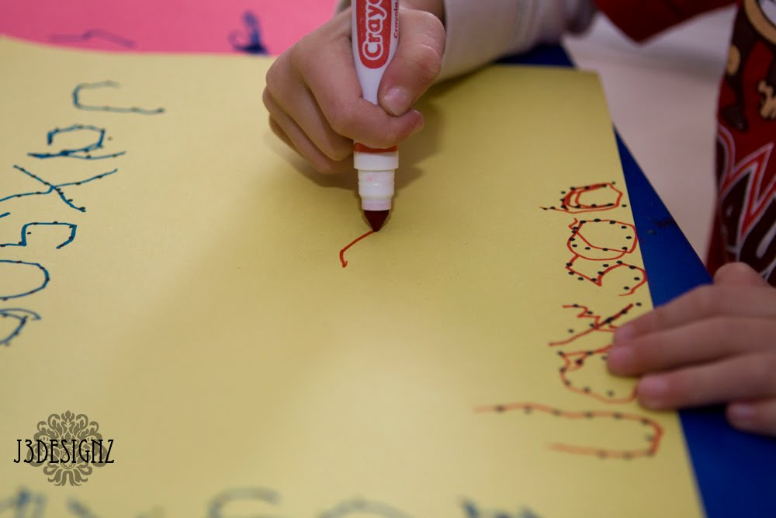
Activity: Learning to print first name
Create a task analysis for printing the name: Jason
Ensure there is a key listing the various prompts
Work in groups of 3: one student, one EA and one observer
Rotate roles

Slide 26
Activity: Learning to print first name
Follow the teacher’s directions
Prompt the student, as necessary, through printing their name
Observer: provide feedback at the end of session
Discuss as a class

Slide 27
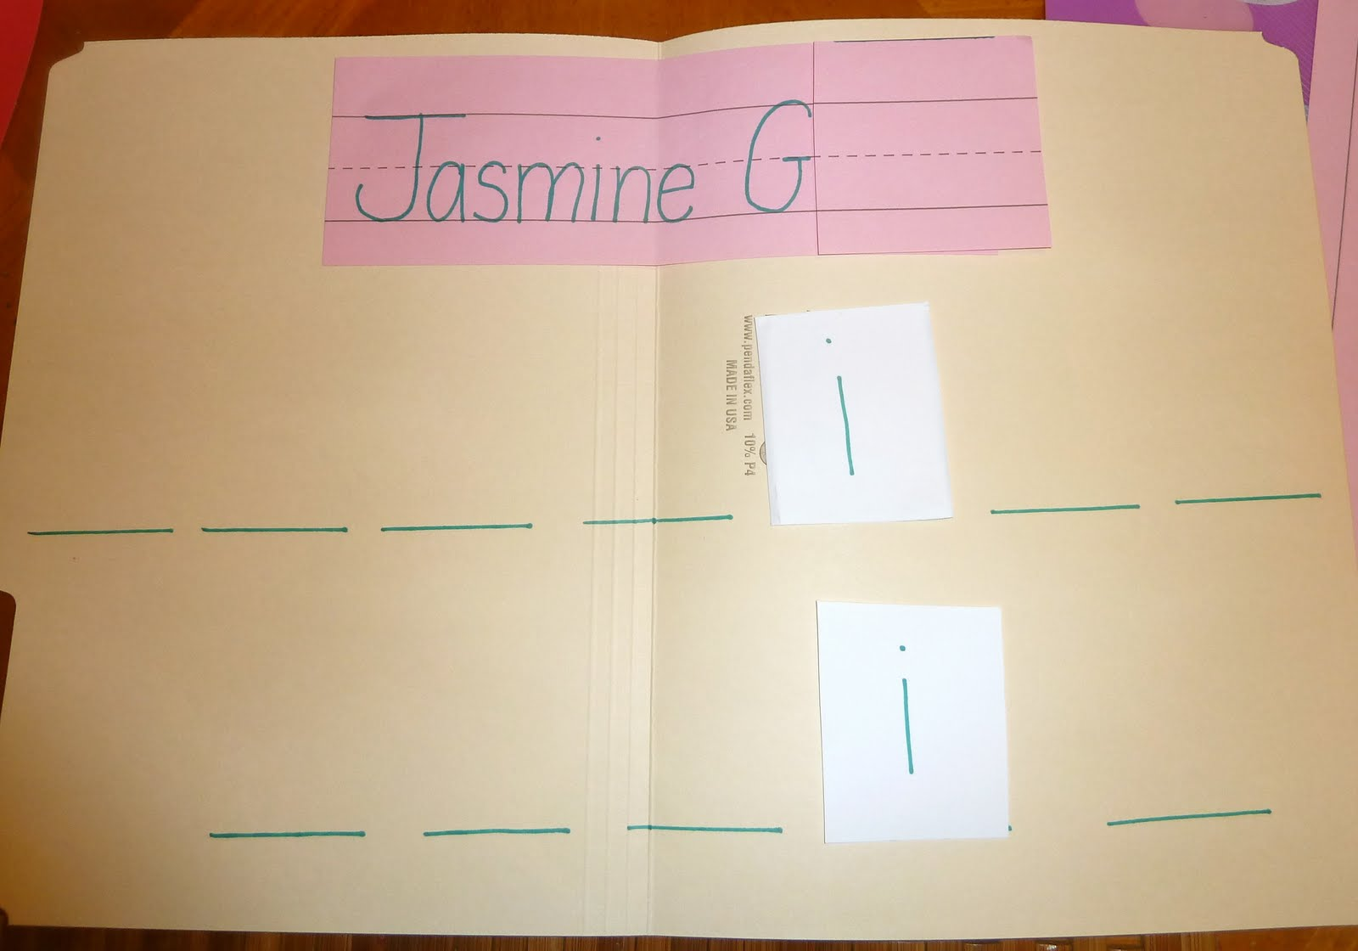
What type of activity is this?

Slide 28
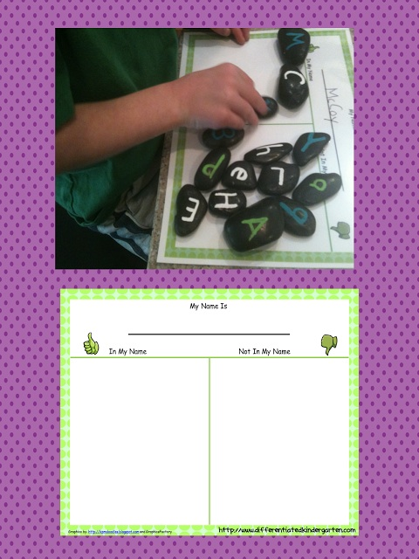
What type of activity is this?

